Slide 1
Leveraging the fact
that our brains can
continually form new pathways
to learning
Laura Holt and Laura Manning
Educational insights
from the field of neuroplasticity

Slide 2
Welcome!
What is something interesting about your brain?
Notes:
Start with our examples: LH – really good memory LM – developing an obsessive condition (locking my car)
Discuss in group of 4 or 5 … A few report out.

Slide 3
What is neuroplasticity?
the selective organizing of connections between neurons in our brains. - neurologist and educator Judy Willis
the ability of the brain to reorganize itself, both in structure and in how it functions
- National Institute for the Clinical Application of Behavioral Medicine
Notes:
LM – 1st one
LH – 2nd one

Slide 4
Purpose of this workshop
to foreground for ourselves what we already know about neuroplasticity
to remind us to teach our students about neuroplasticity
to remind ourselves to build learning activities around neuroplasticity features
Notes:
Start with our examples:
LH – strokes led me to book; retrieval practice with students to strengthen pathways; using students’ existing skills to build new ones
LM – Lang’s Small Teaching reinforced some neuroplasticity concepts; been teaching my students about the growth mindset for awhile
Discuss in group of 4 or 5 … A few report out.

Slide 5
Who are we, and why are we here?
What about neuroplasticity interests you?
What do you already know about it?
Notes:
Start with our examples:
LH – strokes led me to book; retrieval practice with students to strengthen pathways; using students’ existing skills to build new ones
LM – Lang’s Small Teaching reinforced some neuroplasticity concepts; been teaching my students about the growth mindset for awhile
Discuss in group of 4 or 5 … A few report out.

Slide 6
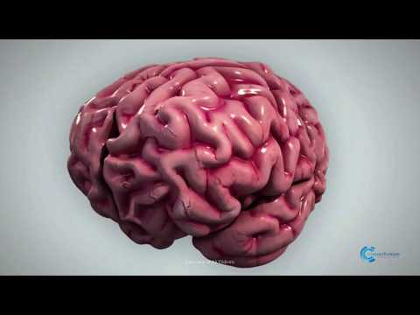
Neuroplasticity and learning
Notes:
Now that we have activated your existing knowledge and interest in the subject, here’s a little teaching about the concept.
https://www.youtube.com/watch?v=88OL8NdkV-s

Slide 7
AGES – factors in neuroplasticity
attention: focus
generation: make connections to previous learning
emotion: positive rewards
spacing: interleaving
Notes:
Start with our examples:
LH – strokes led me to book; retrieval practice with students to strengthen pathways; using students’ existing skills to build new ones
LM – Lang’s Small Teaching reinforced some neuroplasticity concepts; been teaching my students about the growth mindset for awhile
Discuss in group of 4 or 5 … A few report out.

Slide 8
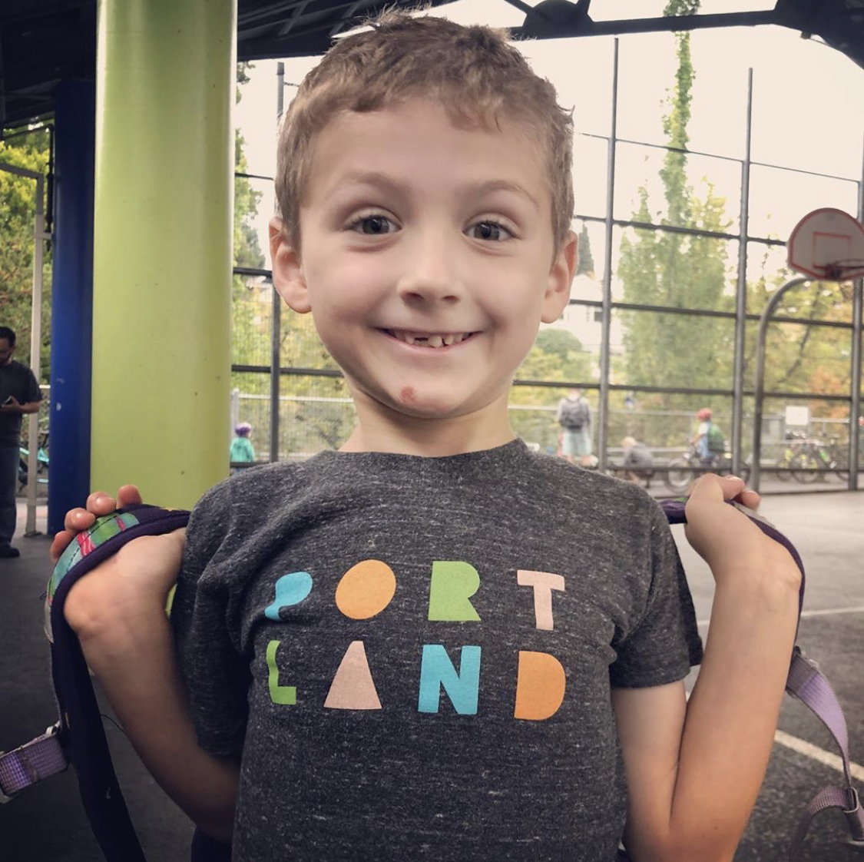
“Aunt Laura, my teacher told me every time I learn something new at school, my brain makes a new line.”
Dylan Holt, age 6

Slide 9
Growth mindset: teaching students about their brains
Dweck: When students believe they can get smarter, they understand that effort makes them stronger. Therefore they put in extra time and effort, and that leads to higher achievement.
7th graders who were taught that intelligence is malleable and shown how the brain grows with effort showed a clear increase in math grades.
Notes:
Start with our examples:
LH – strokes led me to book; retrieval practice with students to strengthen pathways; using students’ existing skills to build new ones
LM – Lang’s Small Teaching reinforced some neuroplasticity concepts; been teaching my students about the growth mindset for awhile
Discuss in group of 4 or 5 … A few report out.

Slide 10
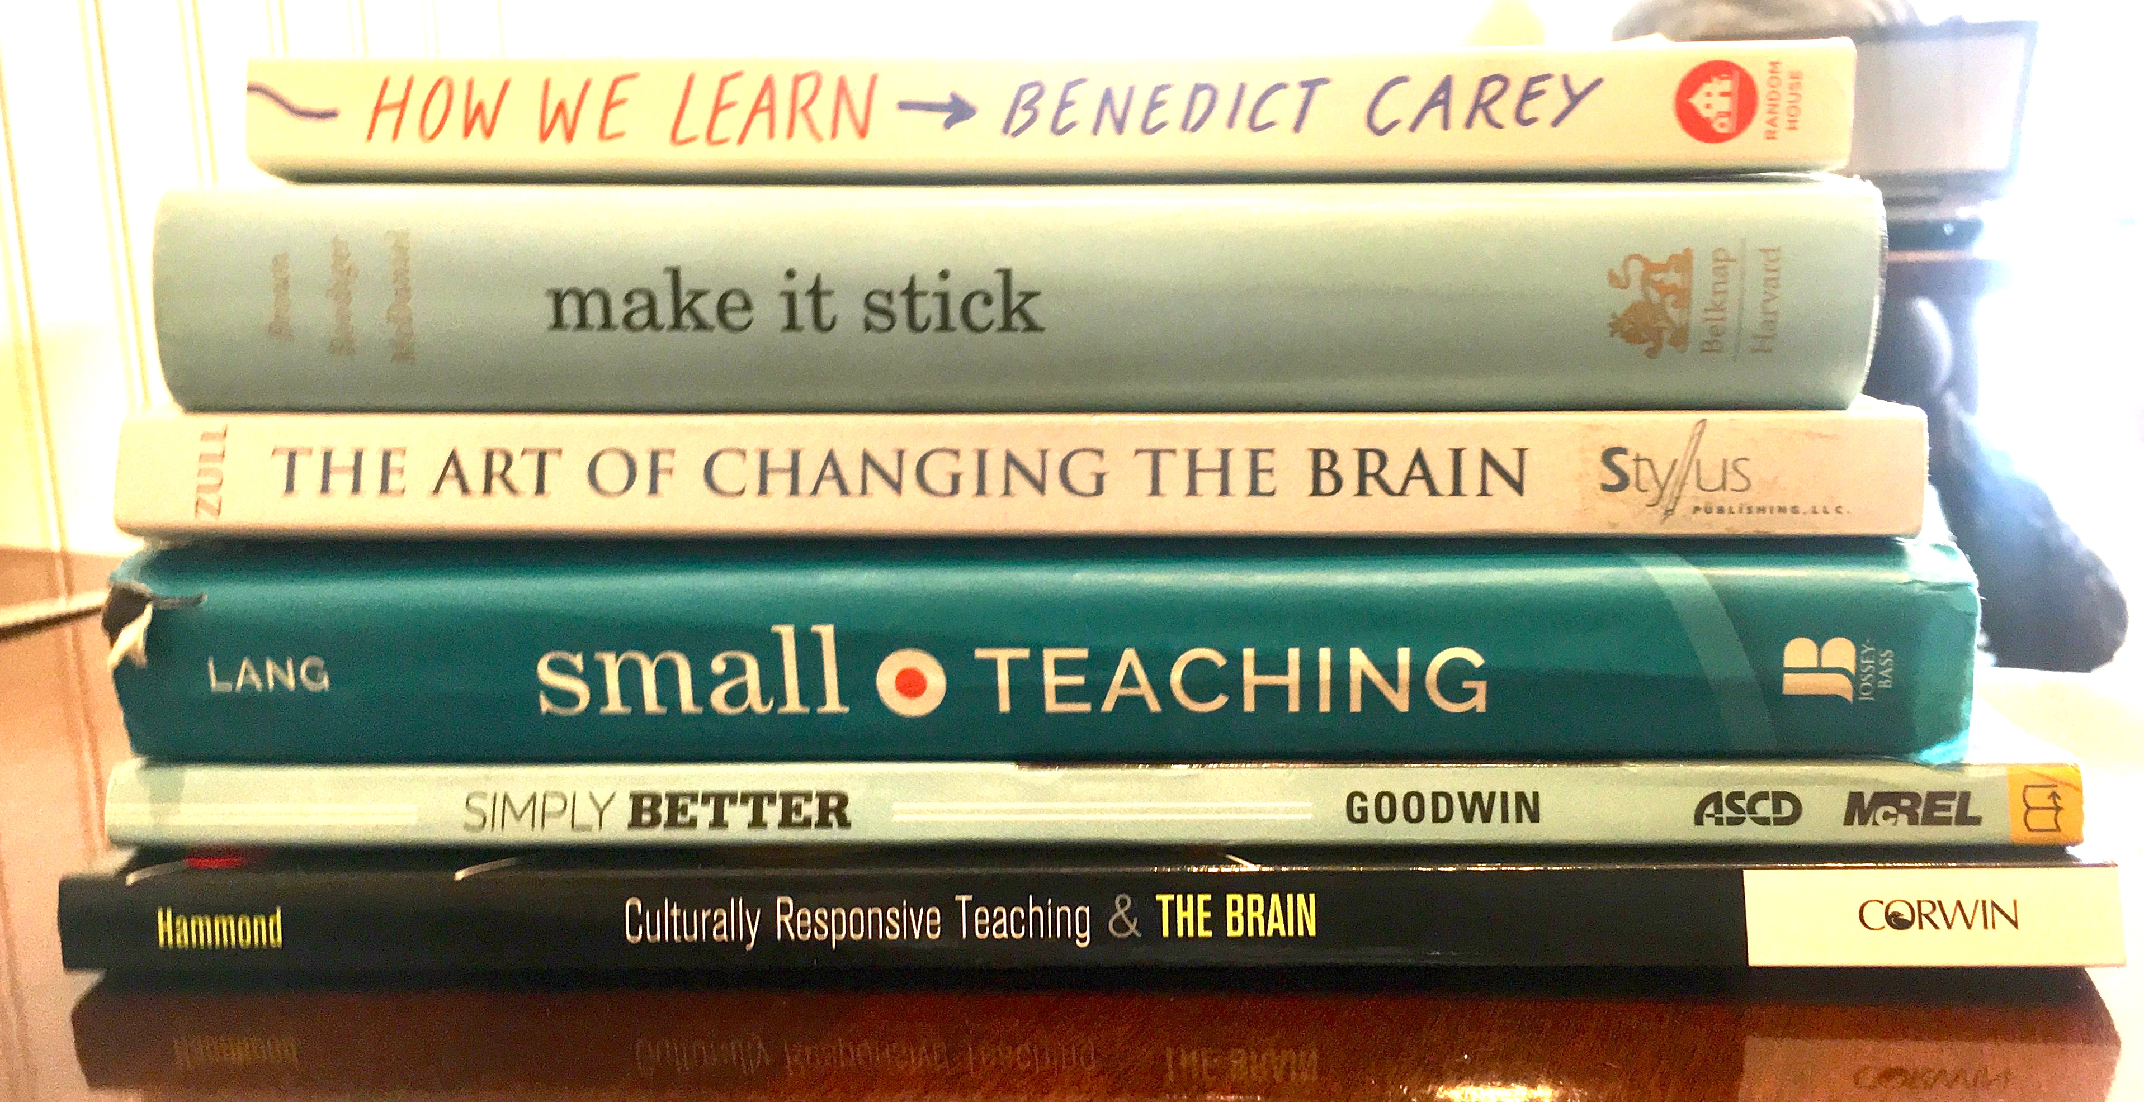

Slide 11
Education’s influence on the brain
learning new ideas and skills creates new or stronger connections between neurons
repetition and practice strengthen neural connections

Slide 12
In defense of active learning
What professionals do in their classes matters far less than what they ask students to do. - Change, 2003

Slide 13
Being disinterested is bad news
for learning
When we're feeling motivated and mindful, ready to take action, our brains release the chemicals and hormones that are required for transformation to take place in our minds.
But when we're feeling distracted or disinterested, our switches for change turn off.

Slide 14
Helping rats’ brains grow
Animals raised in enriched environments surrounded by other animals, objects to explore, toys to roll, ladders to climb, and running wheels learn better than those reared in impoverished environments
Enriched environments increase brain weight by 5% in the cerebral cortex

Slide 15
Studies show other effects of training on the structure and function of the brain
London cab drivers typically have a larger hippocampus than other folks, and they use it to store a detailed mental map of the city
Musicians typically have 130% more grey matter in the auditory cortex
After 10 weeks of mindfulness-based therapy, 12/18 OCD patients improved significantly
Bilinguals who come down with Alzheimer’s do so about 4.5 years later than monolinguals
Notes:
Stephen Hawking story

Slide 16
Neuroplasticity can result from...
Notes:
Discuss!!! This is our handout p1

Slide 17
Questions for discussion
How are you empowering students through teaching them about their own brains’ neuroplasticity (growth mindset)?
What connections are you making between your material and students’ already-existing connections between concepts (prior knowledge, experiences, and skills)?
What kinds of enriched learning environments are you providing for your students?
In what ways are you engaging students’ emotions around the concepts you’re teaching?
How are you leveraging the power of social interaction to help create new connections in students’ brains?
Notes:
This is our handout p2

Slide 18
Takeaways
On your card: what three ideas about neuroplasticity might be top of mind as you plan upcoming learning activities?
Take a picture if you want – we’d like to take the cards up and compile them to get back to you.
Notes:
This is our handout p2

